Slide 1
Throughput and Area Impact of Synchronization in an Open-Source Massively-Parallel Manycore Platform
OSCAR Workshop @ ISCA
June 28, 2026
Victor Isachi¹ - victor.isachi@unibo.it
Angelo Garofalo^{1,2}
Francesco Conti^{1,3}
Davide Rossi^{1,3}
¹University of Bologna, Italy
²ETH Zürich, Switzerland
³Fondazione Chips-IT

Slide 2
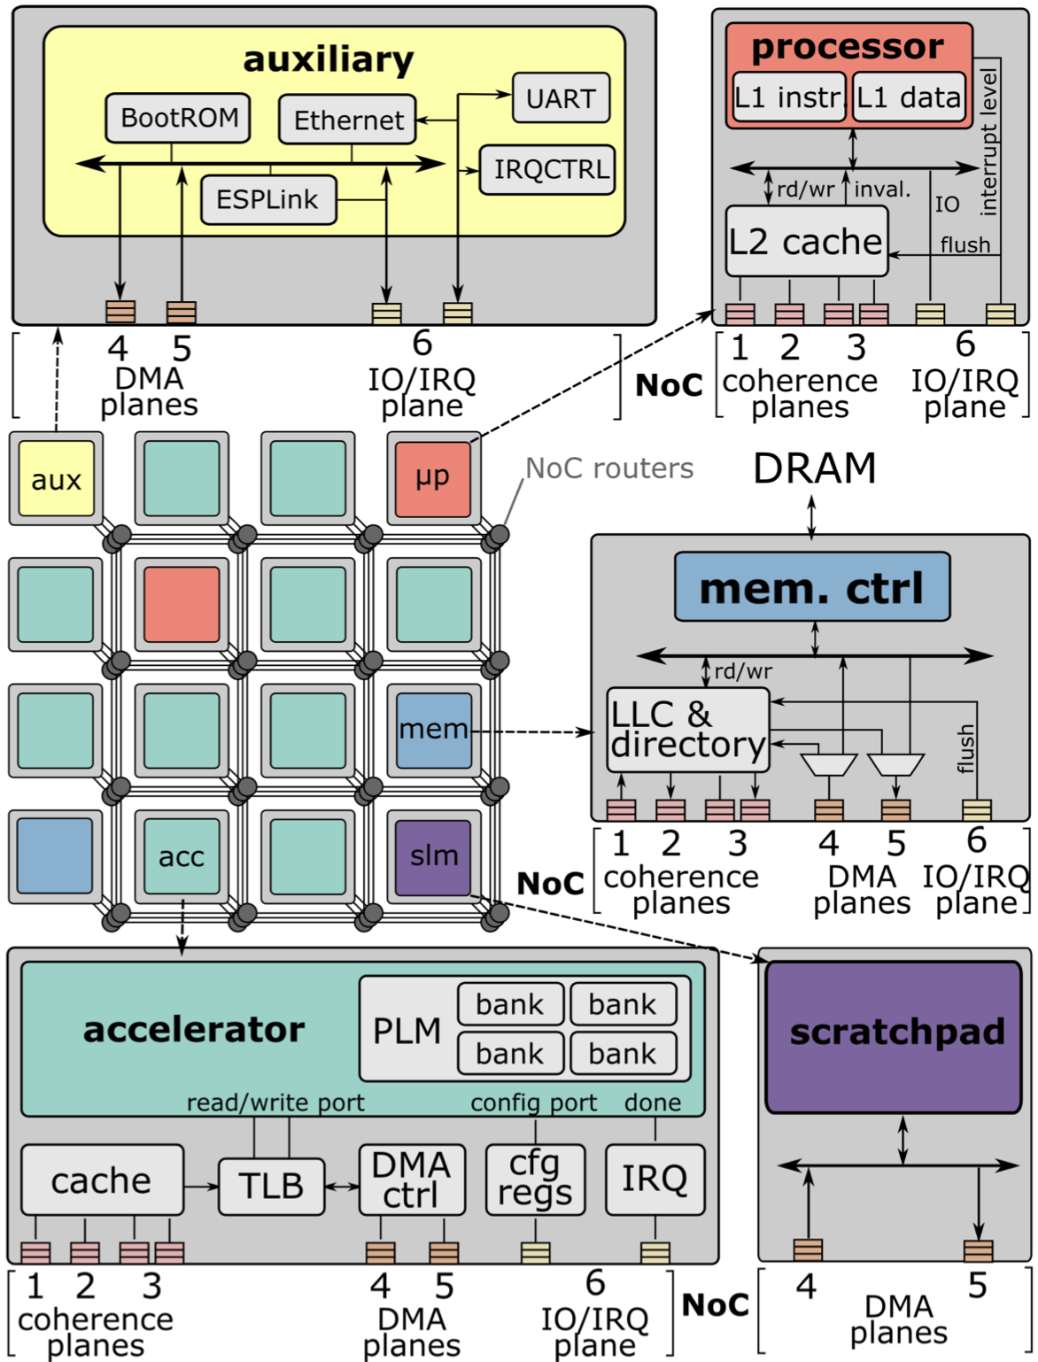
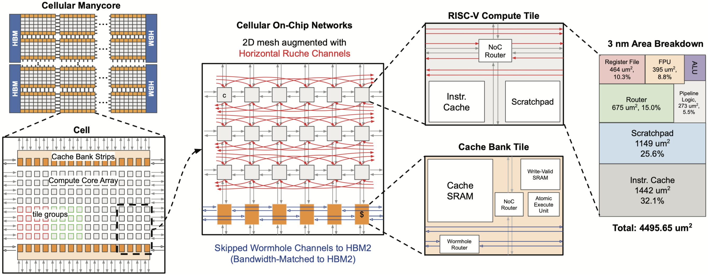
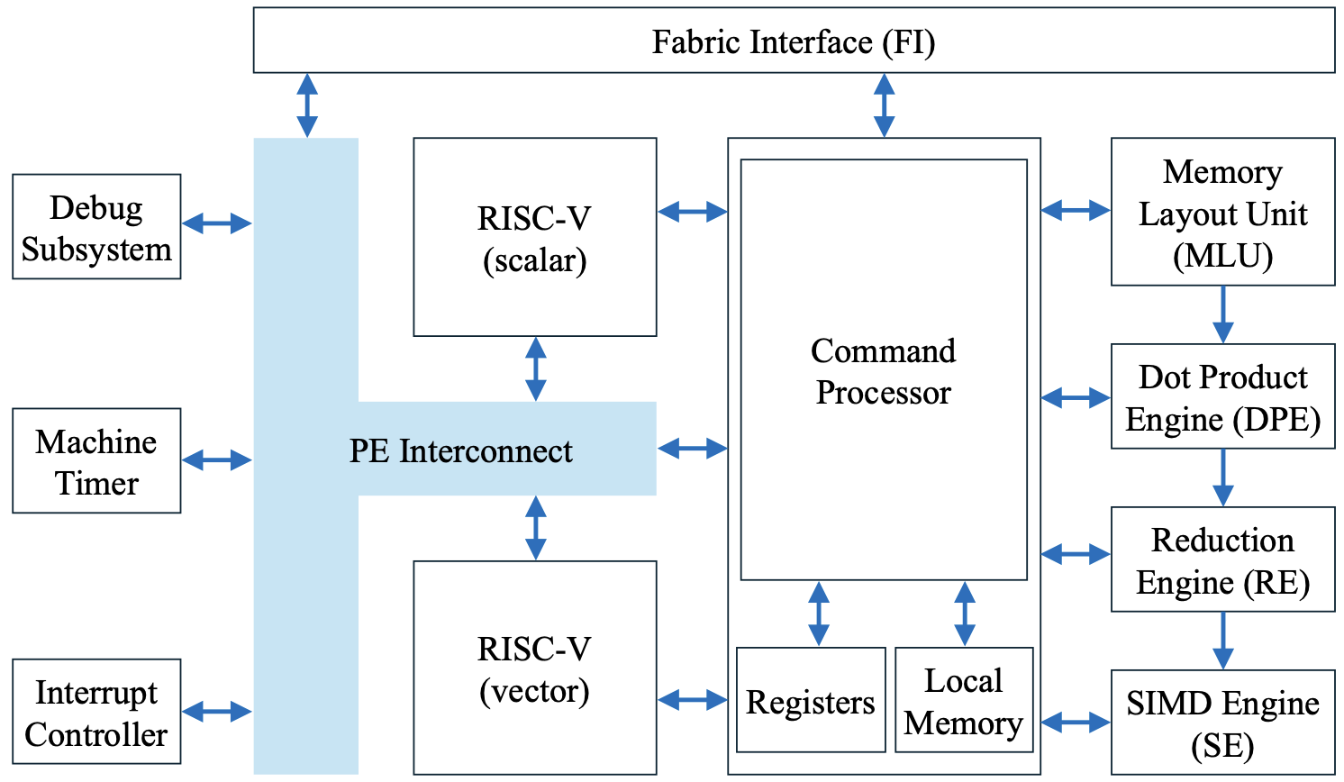
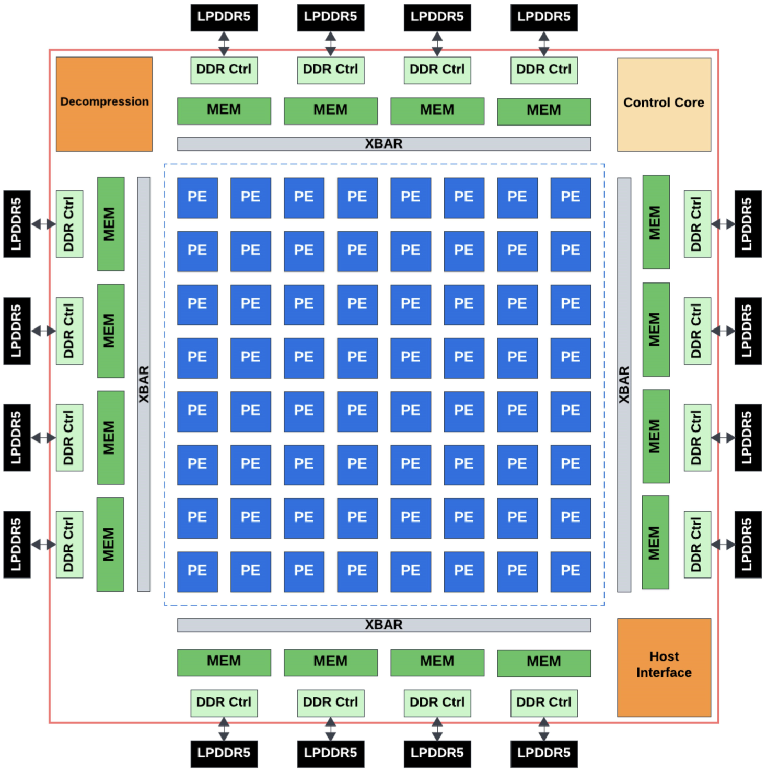
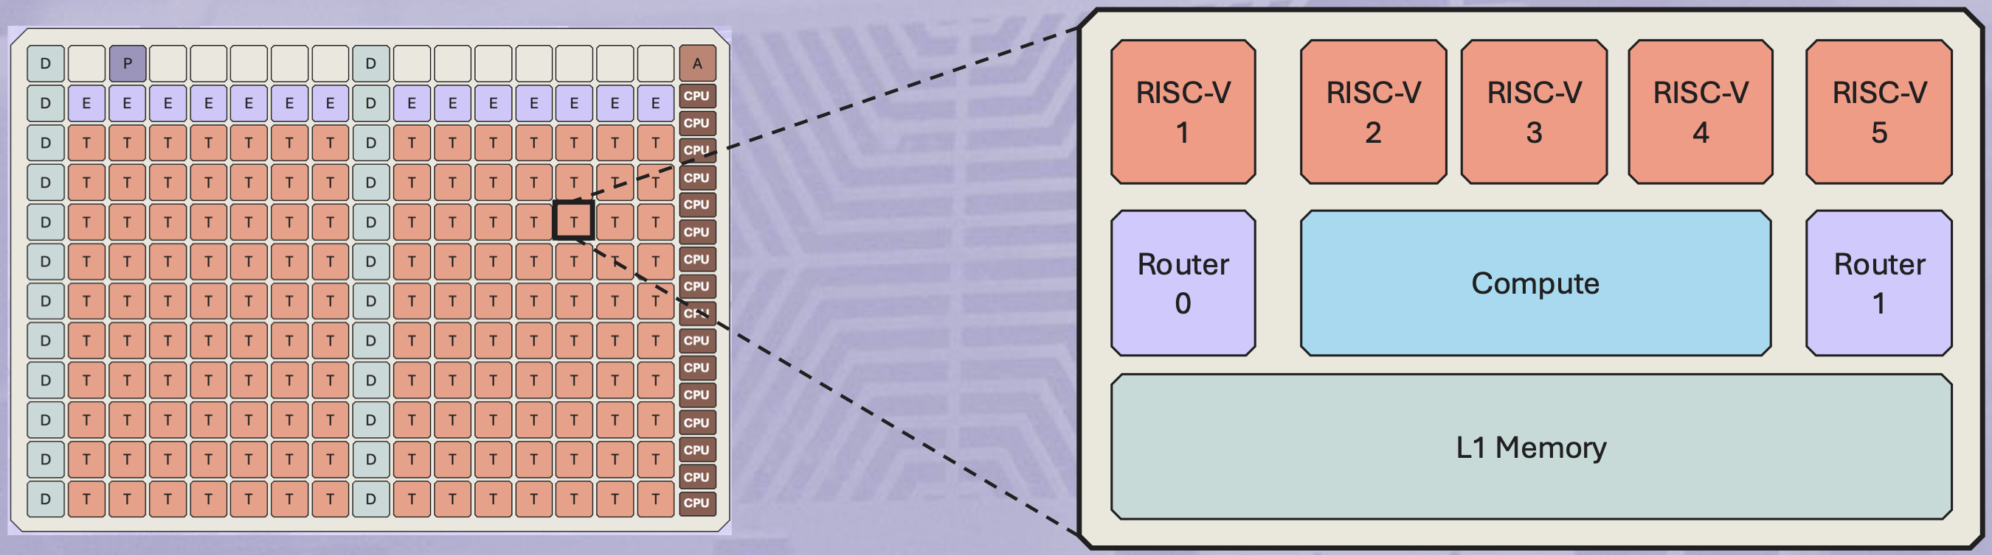
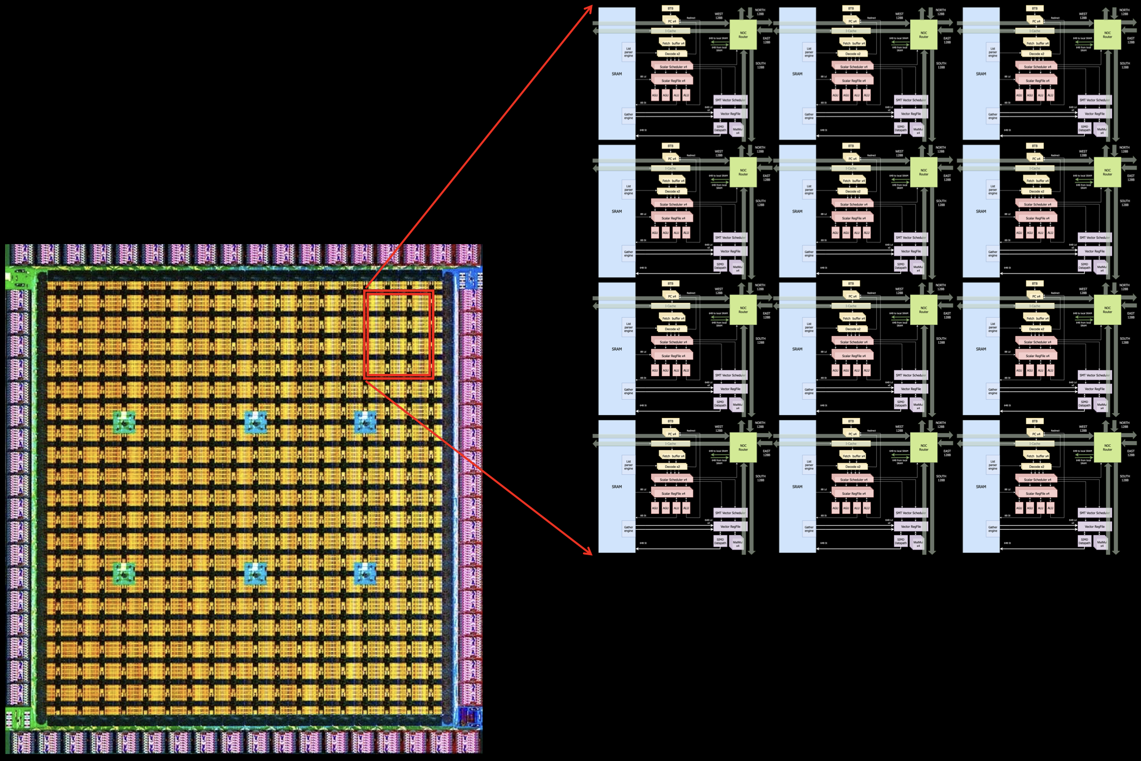
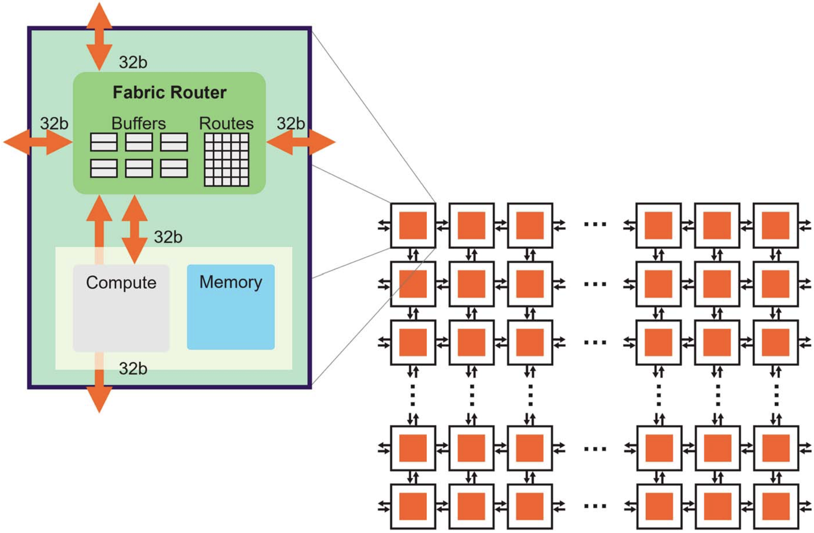
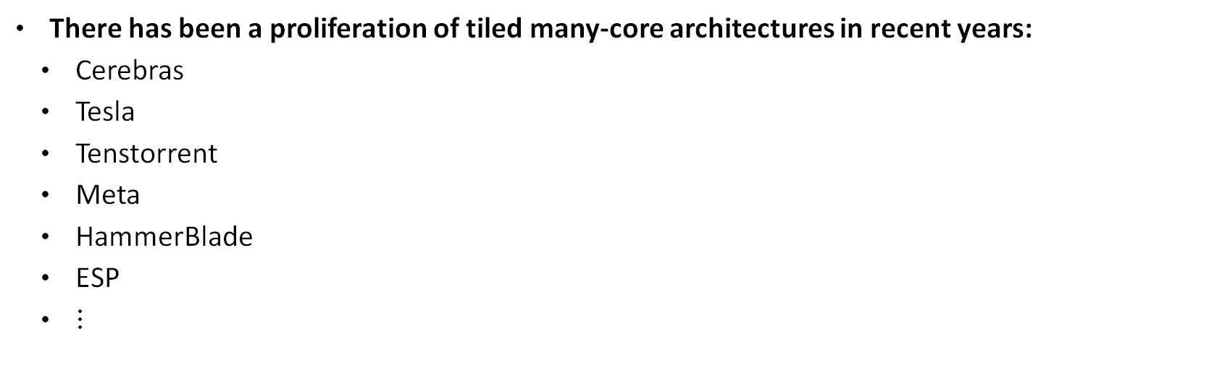

Introduction: Tiled Many-Core Platforms
There has been a proliferation of tiled many-core architectures in recent years:
  Cerebras
  Tesla
  Tenstorrent
  Meta
  HammerBlade
  ESP
  $⋮$
These architectures need to configure tightly-coupled design-space knobs:
  Number of tiles $⟹$ parallel resources, coordination overhead
  Tile-local memory size $⟹$ workload granularity, data reuse
  On a fixed silicon budget these cannot be optimized independently
Coburn, Joel, et al. "Meta's Second Generation AI Chip: Model-Chip Co-Design and Productionization Experiences." Proceedings of the 52nd Annual International Symposium on Computer Architecture. 2025.
Jung, Dai Cheol, et al. "Scalable, programmable and dense: The HammerBlade open-source RISC-V manycore." 2024 ACM/IEEE 51st Annual International Symposium on Computer Architecture (ISCA). IEEE, 2024.
Vasiljevic, Jasmina, and Davor Capalija. "Blackhole & TT-Metalium: The Standalone AI Computer and its Programming Model." HCS. 2024.
Talpes, Emil, Douglas Williams, and Debjit Das Sarma. "Dojo: The microarchitecture of tesla’s exa-scale computer." 2022 IEEE Hot Chips 34 Symposium (HCS). IEEE, 2022.
Lie, Sean. "Cerebras architecture deep dive: First look inside the hardware/software co-design for deep learning." Ieee Micro 43.3 (2023): 18-30.
Tombesi, Gabriele, et al. "Teaching Collaborative SoC Engineering with HLS-Based Accelerator Design and Agile System-Level Integration." Proceedings of the Workshop on Computer Architecture Education. 2025.

Slide 3
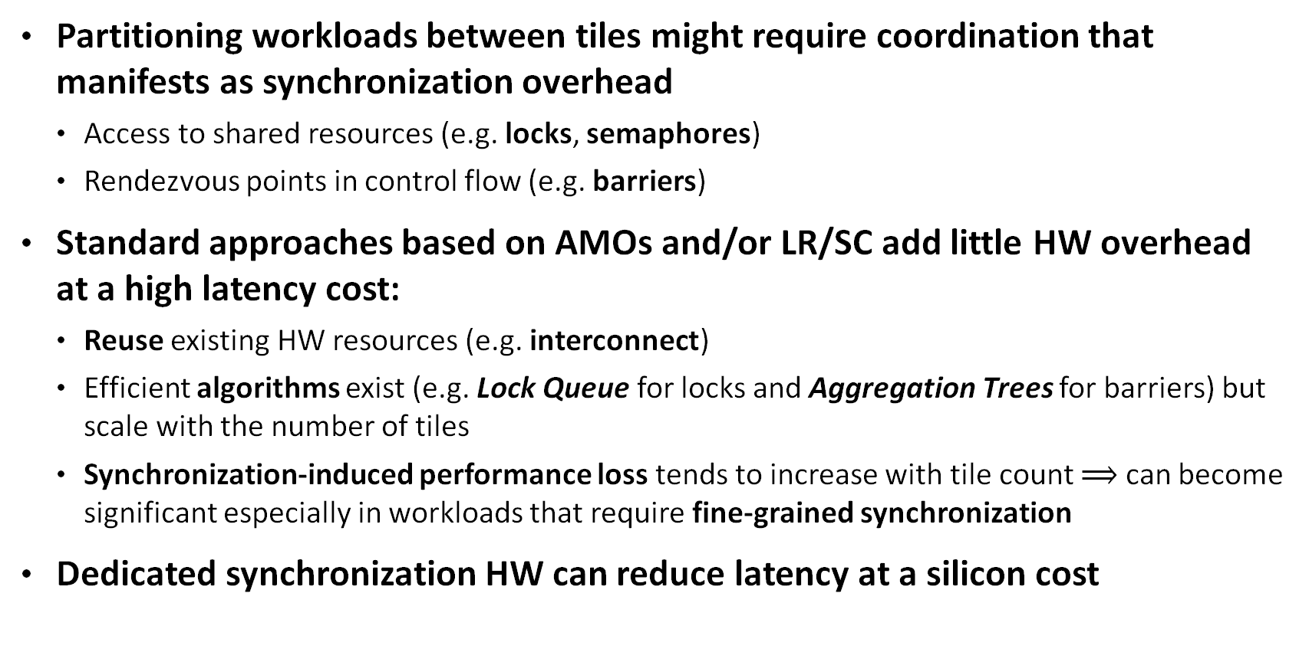
Introduction: Many-Core Synchronization
Partitioning workloads between tiles might require coordination that manifests as synchronization overhead
  Access to shared resources (e.g. locks, semaphores)
  Rendezvous points in control flow (e.g. barriers)
Standard approaches based on AMOs and/or LR/SC add little HW overhead at a high latency cost:
  Reuse existing HW resources (e.g. interconnect)
  Efficient algorithms exist (e.g. Lock Queue for locks and Aggregation Trees for barriers) but scale with the number of tiles
  Synchronization-induced performance loss tends to increase with tile count $⟹$ can become significant especially in workloads that require fine-grained synchronization
Dedicated synchronization HW can reduce latency at a silicon cost
Culler, David, Jaswinder Pal Singh, and Anoop Gupta. “Parallel computer architecture: a hardware/software approach.” ‘Gulf Professional Publishing, 1999.

Slide 4
Motivation
Key Questions:
How should tile count and tile-local memory size be chosen?
  Practical designs are constrained by a silicon budget
When (if ever) is dedicating silicon to synchronization resources advantageous?
  Does this affect the optimal tile count and tile-local memory configuration?
Our Approach:
Analytical models for area and runtime
  Full simulation-based study can be infeasible
  Adapted (gray-box style) to a real open-source platform
Focus on optimizing performance (GFLOPS) at a given area budget

Slide 5
MAGIA
MAGIA is an open-source tiled many-core platform
Each tile features:
  Lightweight RV32IMAFC RISC-V control core with 16 KiB of I$, FPU, EU and CV-X-IF - cv32e40x
  Tile-local L1 SPM (up to 1 MiB) - TCDM
  8x8 semi-systolic GEMM accelerator - RedMulE
  4 transprecision 32-bit FPU VPU - Spatz
  256-bit AXI4 DMA - iDMA
  Local and NoC interconnect - AMO, NI, Router, HCI
github.com/pulp-platform/MAGIA

Slide 6
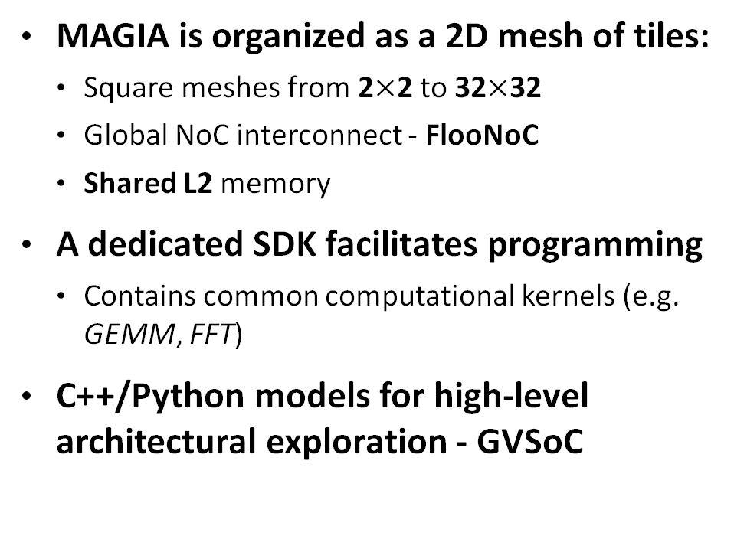
MAGIA (cont’d)
MAGIA is organized as a 2D mesh of tiles:
  Square meshes from 2$×$2 to 32$×$32
  Global NoC interconnect - FlooNoC
  Shared L2 memory
A dedicated SDK facilitates programming
  Contains common computational kernels (e.g. GEMM, FFT)
C++/Python models for high-level architectural exploration - GVSoC
github.com/pulp-platform/magia-sdk

Slide 7
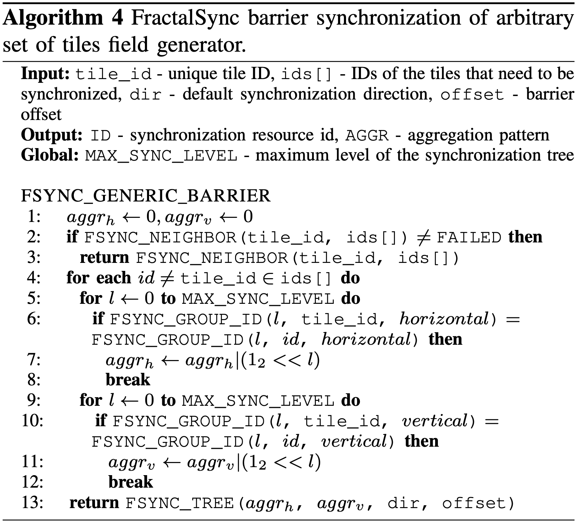
FractalSync
FractalSync (FS) is an open-source HW-SW mechanism for low-latency synchronization:
  Low-diameter horizontal/vertical Fat H-Tree + Mesh networks
  Low-latency synchronization HW managers
  API with synchronization primitives and algorithms to effectively utilize them
Configurable number of HW resources
  We consider the single-thread-per-tile arbitrary non-blocking locks and barriers
github.com/VictorIsachi/fractal_sync

Slide 8
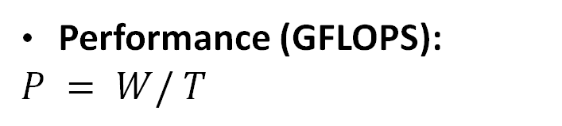
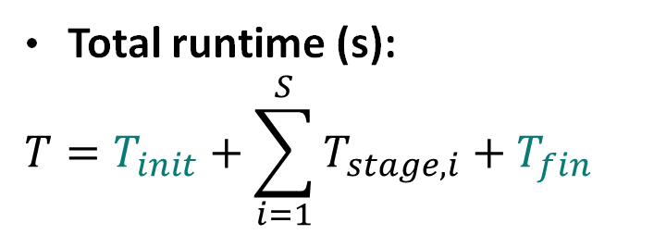



Double-Buffered Runtime Model
Leveraging double buffering can increase performance at a memory cost
  We assume double buffering in our analysis (iDMA, Spatz and RedMulE can work concurrently)
  The workloads we consider (GEMM, FFT) use it
Total runtime (s):
$$T=T_{init}+\sum_{i=1}^{S}{T_{stage,i}}+T_{fin}$$
$$T_{stage,i}=Q_{stage}+\max\left(T_{comp,i},T_{comm,i}\right)+T_{sync,i}$$
$$Q_{j}\sim N\left(μ_{j},σ_{j}^{2}\right)$$
$$T_{init}=Q_{init}+T_{comm,init}+\left[T_{sync,init}\right]$$
$$T_{fin}=Q_{fin}+T_{comm,fin}+\left[T_{sync,fin}\right]$$
Performance (GFLOPS):
$$P = W/ T$$

Slide 9

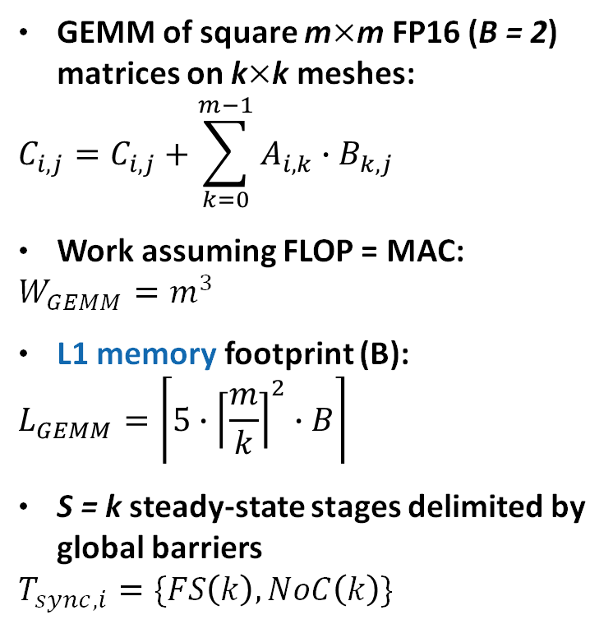
Double-Buffered GEMM Runtime Model
L2 access is assumed to saturate NoC BW after a ramp-up time
Assumptions
Runtime Model
GEMM of square m$×$m FP16 (B = 2) matrices on k$×$k meshes:
$$C_{i,j}=C_{i,j}+\sum_{k=0}^{m−1}{A_{i,k}}∙B_{k,j}$$
Work assuming FLOP = MAC:
$$W_{GEMM}=m^{3}$$
L1 memory footprint (B):
$$L_{GEMM}=\left\lceil 5∙{\left\lceil \frac{m}{k}\right\rceil }^{2}∙B\right\rceil$$
S = k steady-state stages delimited by global barriers
$$T_{sync,i}=\{FS\left(k\right),NoC\left(k\right)\}$$
$$T_{comm,init}=\left\lceil \frac{3m^{2}B}{k∙BW_{NoC}}+2kH\right\rceil \\ T_{comm,fin}=\left\lceil \frac{m^{2}B}{k∙BW_{NoC}}+2kH\right\rceil \\ T_{comp,i}=\left\lceil \frac{{\left(m/k\right)}^{3}}{MAC_{RedMulE}∙U_{RedMulE}\left(n\right)}\right\rceil \\ T_{comm,i}=\left\lceil \frac{{\left(m/k\right)}^{2}B}{BW_{NoC}∙U_{NoC}\left(n\right)}+A_{NoC}+4H\right\rceil \\ Q_{init/fin}\sim N\left(100,10\right),Q_{stage}\sim N\left(50,10\right), \\ BW_{NoC}=10B/c,H=2c, \\ MAC_{RedMulE}=64MAC/c, \\ U_{RedMulE/NoC}=0.95,A_{NoC}=4c$$
Computation is offloaded to the GEMM accelerator, workload size is assumed to achieve high utilization
Glad to discuss in detail offline
Communication is assumed to have constant NoC hops, tile access and NoC hop latencies
Parameters estimated via cycle-accurate RTL simulation

Slide 10

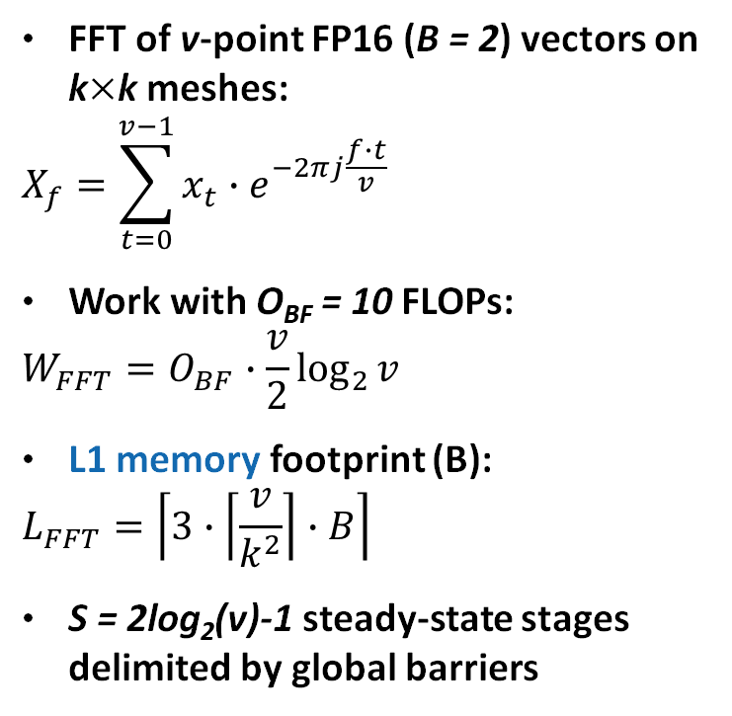
Double-Buffered FFT Runtime Model
L2 access is assumed to saturate NoC BW after a ramp-up time
Assumptions
Runtime Model
FFT of v-point FP16 (B = 2) vectors on k$×$k meshes:
$$X_{f}=\sum_{t=0}^{v−1}{x_{t}}∙e^{−2πj\frac{f∙t}{v}}$$
Work with O_{BF} = 10 FLOPs:
$$W_{FFT}=O_{BF}∙\frac{v}{2}\log_{2}{v}$$
L1 memory footprint (B):
$$L_{FFT}=\left\lceil 3∙\left\lceil \frac{v}{k^{2}}\right\rceil ∙B\right\rceil$$
S = 2log₂(v)-1 steady-state stages delimited by global barriers
$$T_{comm,L2}=\left\lceil \frac{\left(v/2\right)B}{k∙BW_{NoC}}+2kH\right\rceil \\ T_{comp,i}=\left\lceil L_{BF}\left\lceil \frac{\left(v/2k^{2}\right)/2}{BF_{Spatz}}\right\rceil \right\rceil$$
$$T_{comm,init/fin}=$$
$T_{comm,L2}+\max\left(T_{comm,L2},T_{comp,i}\right)$
$$T_{comm,i}=$$
$\left\lceil \frac{\left(v/2k^{2}\right)B}{BW_{NoC}∙U_{NoC}\left(n\right)}+A_{NoC}+\left(2^{\left\lceil i/4\right\rceil −1} mod k^{2}\right)H\right\rceil$
$$Q_{init/fin}\sim N\left(100,10\right),Q_{stage}\sim N\left(50,10\right), \\ BW_{NoC}=10B/c,H=2c,L_{BF}=43c, \\ BF_{Spatz}=8,U_{NoC}=0.95,A_{NoC}=4c$$
Computation is offloaded to Spatz which can perform up to 8 butterflies in parallel
Glad to discuss in detail offline
A steady-state slot corresponds to half a butterfly stage
Communication is assumed to follow the hypercube pattern and have constant tile access and NoC hop latencies
Cycle-accurate RTL simulation

Slide 11
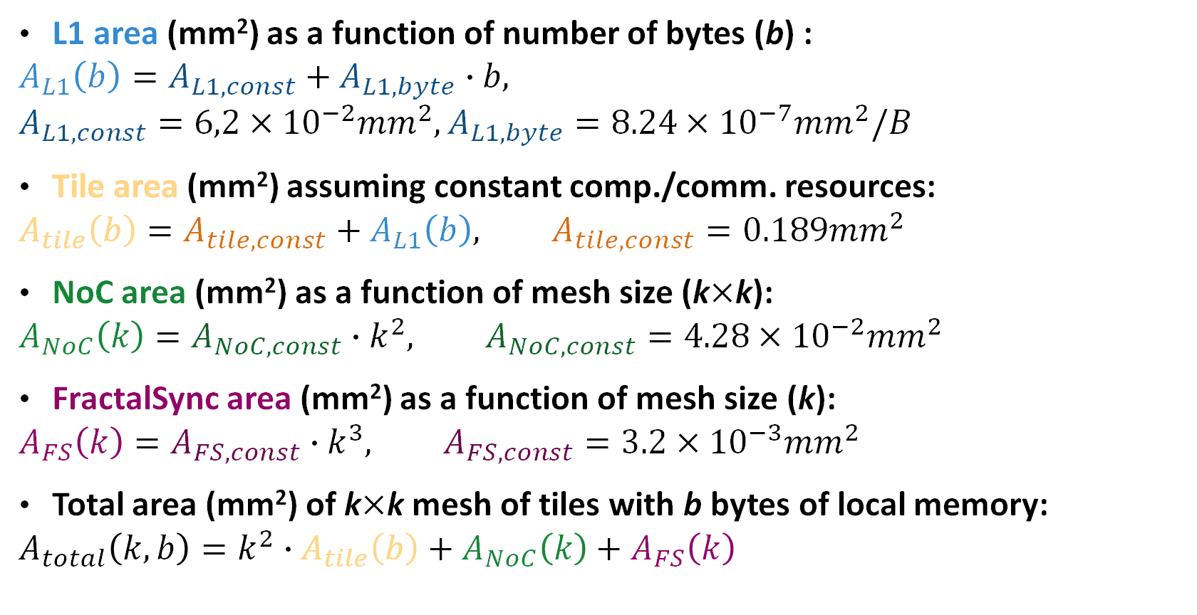
MAGIA Area Model
L1 area (mm²) as a function of number of bytes (b) :
$$A_{L1}\left(b\right)=A_{L1,const}+A_{L1,byte}∙b, \\ A_{L1,const}=6,2×{10}^{−2}mm^{2},A_{L1,byte}=8.24×{10}^{−7}mm^{2}/B$$
Tile area (mm²) assuming constant comp./comm. resources:
$$A_{tile}\left(b\right)=A_{tile,const}+A_{L1}\left(b\right), A_{tile,const}=0.189mm^{2}$$
NoC area (mm²) as a function of mesh size (k$×$k):
$$A_{NoC}\left(k\right)=A_{NoC,const}∙k^{2}, A_{NoC,const}=4.28×{10}^{−2}mm^{2}$$
FractalSync area (mm²) as a function of mesh size (k):
$$A_{FS}\left(k\right)=A_{FS,const}∙k^{3}, A_{FS,const}=3.2×{10}^{−3}mm^{2}$$
Total area (mm²) of k$×$k mesh of tiles with b bytes of local memory:
$$A_{total}\left(k,b\right)=k^{2}∙A_{tile}\left(b\right)+A_{NoC}\left(k\right)+A_{FS}\left(k\right)$$
Estimates obtained from post-layout for GF’s 12nm FinFET technology at 1GHz
Glad to discuss in more detail offline

Slide 12

Evaluation Results - GEMM
Sweep workload size from 32x32 to 1024x1024 with fixed area budgets ranging from 32 to 512 mm² to determine:
  Best obtainable performance and the associated mesh configuration (w/ and w/o FS)
  Relation between workload size and optimal mesh configuration
  Impact of dedicated synchronization hardware in terms of speedup
Takeaway:
FractalSync improves GEMM throughput by making larger meshes beneficial under the same area budget, reaching up to 2.79$×$ speedup and 22TFLOPS (vs. 12.5TFLOPS), despite GEMM being relatively compute-intensive

Slide 13
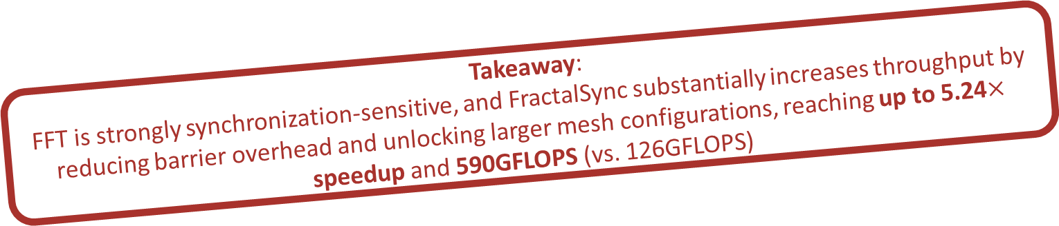
Evaluation Results - FFT
Workload size ranging from 2¹¹ to 2¹⁶ with same 32 to 512 mm² area budgets
In our setup we observe that:
  Speedup is workload dependent, but throughput is increased by the dedicated synchronization mechanism
  Low-latency synchronization “unlocks” larger mesh configuration with more comp. resources
Takeaway:
FFT is strongly synchronization-sensitive, and FractalSync substantially increases throughput by reducing barrier overhead and unlocking larger mesh configurations, reaching up to 5.24$×$ speedup and 590GFLOPS (vs. 126GFLOPS)

Slide 14
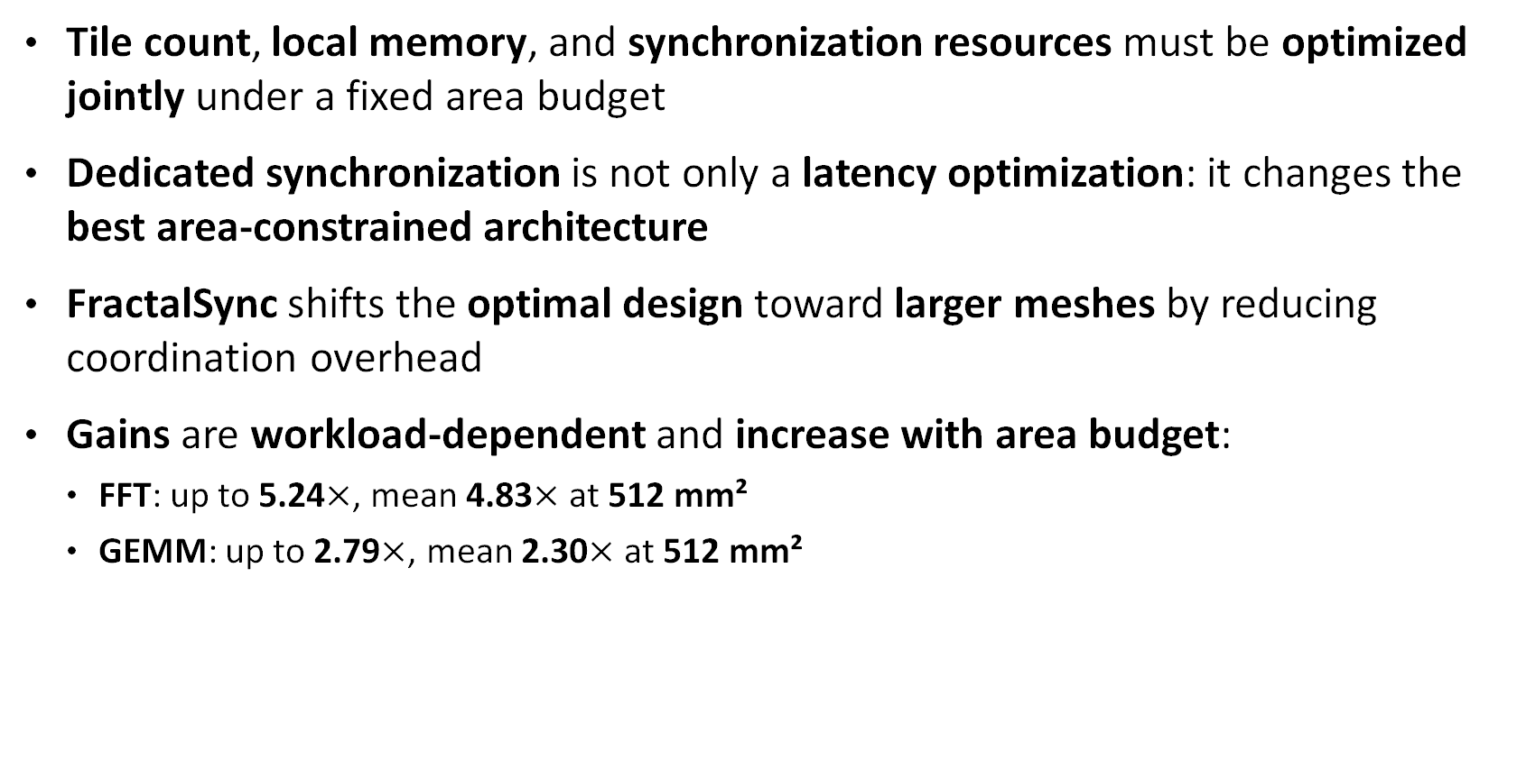
Conclusion
Tile count, local memory, and synchronization resources must be optimized jointly under a fixed area budget
Dedicated synchronization is not only a latency optimization: it changes the best area-constrained architecture
FractalSync shifts the optimal design toward larger meshes by reducing coordination overhead
Gains are workload-dependent and increase with area budget:
  FFT: up to 5.24$×$, mean 4.83$×$ at 512 mm²
  GEMM: up to 2.79$×$, mean 2.30$×$ at 512 mm²
Main takeaway:
low-latency synchronization can be a first-class architectural knob for scalable tiled manycores

Slide 15
Thank You! Questions?
Victor Isachi victor.isachi@unibo.it

